Slide 1
Career connect A Smart Placement & Internship Portal
PBL Group 29
Team Members : Ayush Butala Samyak Gaikwad Aadish Sonawane Siddhi Lolge Pratik Dhawale

Slide 2
Introduction
• The placement and internship process plays a vital role in a student’s transition from academics to professional life. However, many colleges struggle with efficiently organizing and managing this process. Students often face difficulties in finding relevant job and internship opportunities, while placement officers encounter challenges in handling large volumes of data.
• To address these issues, this project proposes a college-specific placement and internship platform that streamlines the process for both students and administrators. By leveraging technology, the platform aims to provide personalized recommendations, structured data management, and a more engaging placement experience

Slide 3
MOTIVATION
The placement and internship process is often unstructured and stressful for students
Students struggle to find relevant job & internship opportunities efficiently
Placement officers have difficulty managing student data & company listings
Lack of motivation for students to improve coding skills and CGPA
Gamification techniques like leaderboards can boost engagement

Slide 4
PROBLEM STATEMENT
The placement and internship process in colleges is often disorganized, making it difficult for students to find relevant opportunities and for placement officers to manage data efficiently. This project aims to create a college-specific platform that recommends jobs and internships based on CGPA and skills, motivates students through a gamified leaderboard, and provides an admin dashboard for streamlined management.

Slide 5
Tech Stack
• Frontend (User Interface)
-React.js – For building an interactive and responsive UI.
-Redux (Optional) – For state management.
-Tailwind CSS / Material-UI – For modern UI design and styling.
• Backend (Server & Logic)
-Node.js & Express.js – To handle API requests and business logic.
-JWT Authentication – For secure login and user authentication.
• Database (Data Storage & Management)
-MongoDB (NoSQL) – To store student profiles, job postings, leaderboard data, and company information.
•Tech Stack: MERN Stack (MongoDB, Express.js, React.js, Node.js)

Slide 6
Literature survey
Sr. no. | Paper Title | Year | Description
1. | Enhancing Job Recommendation Systems through Machine Learning | 2024 | • This paper explores the use of machine learning to improve job and internship recommendations for students. It focuses on matching opportunities based on CGPA, skills, and interests, ensuring better career guidance.
2. | Examining the Effectiveness of Gamification as a Tool Promoting Intrinsic and Extrinsic Motivation Among Higher Education Students: A Systematic Review | 2023 | •This study examines the role of gamification, including leaderboards and competition, in enhancing student motivation. It discusses both intrinsic (self-driven) and extrinsic (reward-driven) motivation, showing how gamification can sustain long-term engagement.

Slide 7
Literature survey
3. | The Use of Leaderboards in Education: A Systematic Review of Empirical Evidence in Higher Education | 2024 | •This paper provides a systematic review of how leaderboards impact student motivation, engagement, and learning outcomes in higher education. It highlights the effectiveness of competitive ranking systems in improving academic participation.
4. | Using Internship Management System to Improve the Relationship between Internship Seekers, Employers, and Educational Institutions | 2020 | • This paper discusses an internship management system designed to enhance communication between students, employers, and educational institutions. It emphasizes better tracking, real-time company listings, and streamlined internship applications.

Slide 8
Objective
Create a web-based platform for college-specific internship & job recommendations
Provide a gamified ranking system to encourage skill development
Offer an admin dashboard for placement officers to manage recruitment efficiently
Help students make data-driven decisions about career opportunities
Increase student participation through leaderboards & performance tracking

Slide 9
Proposed Methodology
1. Data Collection
Gathering student profiles
Tracking CGPA and academic performance
Evaluating coding scores
2. Job Matching
Implementing AI-driven job recommendation algorithms
Mapping student skills to job requirements
Analysing employer expectations
3. Gamification
Introducing a leaderboard system
Tracking performance metrics
Enhancing engagement through interactive features
4. Deployment
Hosting on cloud platforms like AWS/GCP
Conducting scalability testing
Optimizing system performance

Slide 10
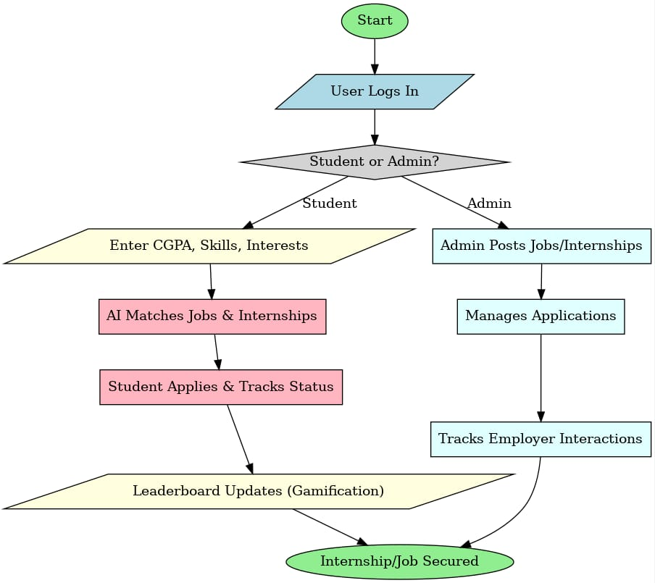
FLOWCHART

Slide 11
Expected benefits
For Students:
Easy access to internships and jobs based on CGPA and skills
Increased motivation through leaderboard rankings
Improved career planning with data-driven insights
For Placement Officers:
A centralized platform for managing students and companies
Simplified tracking of student performance and applications
For Companies:
Access to a filtered pool of qualified candidates
Efficient hiring through a dedicated recruitment panel

Slide 12
conclusion
Career Connect provides a structured, efficient, and engaging way to manage college placements & internships
Gamification & data-driven insights ensure students stay motivated and competitive
Placement officers get a centralized system to handle recruitment more efficiently

Slide 13
THANK YOU!

